Slide 1
Testing Ansible Roles Using Molecule
Estu Fardani | openSUSEAsia Summit | 20171021

Slide 2



Estu Fardani
Ops at Peentar.id
Release Manager at BlankOn Linux
Master at Binar Academy
@tuanpembual | estu@blankon.id
https://github.com/tuanpembual/molecule-ansible

Slide 3
Molecule
Molecule framework to aid in the development and testing of Ansible roles. Base on Ansible-Galaxy.
Support multiple:
instances,
operating systems and distributions,
virtualization providers,
test frameworks,
testing scenarios.

Slide 4
Molecule
To make sure result of ansible role consistent, well-write, easy to understand and maintain.
Install stable v1.2 via pip:
$ sudo pip install molecule
Deps:
* your flavour provider | docker or vagrant

Slide 5
Initiation Molecule
$ molecule init --role nginx \\
--verifier serverspec \\
--driver docker
$ cd nginx; bundle install

Slide 6
Setup OS env
molecule.yml
docker:
containers:
- name: nginx
image: opensuse
image_version: latest
privileged: True
command: /bin/bash

Slide 7
Add Task
tasks/main.yml
---
# tasks file for nginx
- name: install packages
zypper: name={{ item }} update_cache=yes force=yes
with_items:
- nginx
- curl
- net-tools
become: yes
notify:
- restart nginx

Slide 8
Setup Handler to Restart Nginx
handlers/main.yml
---
# handlers file for nginx
- name: restart nginx
service: name=nginx state=restarted
become: yes

Slide 9
Test Frameworks
Default: tox, writing in python
But, I like ruby style. So I using ServerSpec.org.
Resource:
Check package installed
Check service running
Check port listening

Slide 10
Setup Testing Scenario
spec/default_spec.rb
require 'spec_helper'
describe service('nginx') do
it { should be_running }
end
describe port(80) do
it { should be_listening }
end

Slide 11
Run Molecule
$ molecule --help
$ molecule test
It will do:
Create instance
Apply role
Run test
Destroy instance

Slide 12
Split Environment
Env Development | for run molecule test on local
Staging | for run staging env
Prod | for run prod env
But you can always add more env

Slide 13
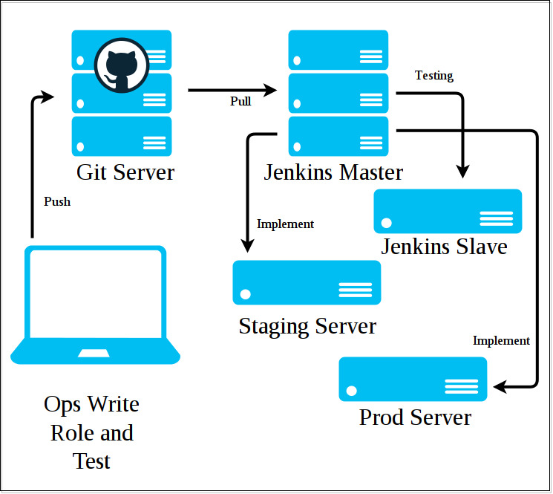
Picture

Slide 14
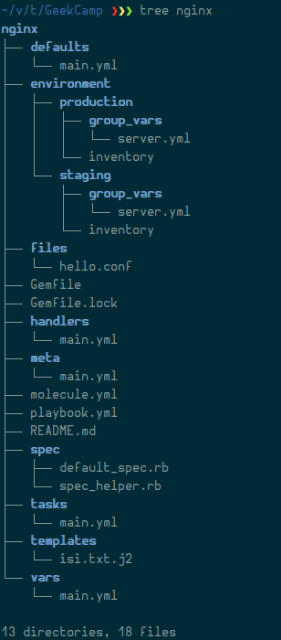
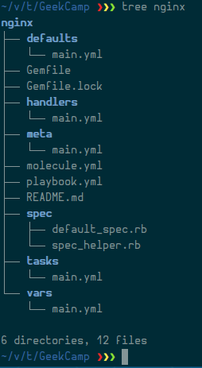
Additional Folder

Slide 15
Implement
After roles pass all test, it is ready to apply directly to our server.
Run from jenkins:
Install ansible in jenkins slave
Testing ssh
Run ansible from outer nginx role folder as jenkins shell script
$ ansible-playbook nginx/playbook.yml -i nginx/environment/staging --user ubuntu

Slide 17
QUESTION
1...

Slide 18
Documentations
http://github.com/metacloud/molecule
http://molecule.readthedocs.io/

Slide 19
ありがとうTERIMAKASIH

